Slide 1
Unlocking the Power of AI New Article Analysis NATURAL LAGUAGE PROCESSING FINAL PROJECT
Submitted by
Swathi Ganesan
12372237

Slide 2
Executive Summary
MISSION
To analyse trends in technology news articles by best leveraging NLP techniques in order to identify the potential of AI and drive a paradigm shift to promote adoption of novel technologies like AI and automation
DRIVERS
Driven by the need for efficiency, innovation, and the transformative power of AI, we are dedicated to uncovering opportunities to automate tasks and enhance employee productivity
CHALLENGES
Ensuring ethical and responsible AI adoption, and staying at the forefront of evolving AI technologies and algorithms
Outcomes
Identified areas where task automation can be employed to enhance employee productivity, through the adoption of AI technologies while considering the negative sentiments associated with AI, such as privacy concerns, ethical considerations, cybersecurity, and environmental impact

Slide 3
Analysis Process Flow
Data Cleaning
De-duplication using Yelp trained SVM sentiment model
Custom Sentiment Analysis
Using twitter-roberta-base-sentiment and distilroberta-finetuned-financial-news-sentiment-analysis
with custom thresholds for Positive, Negative and Neutral sentiments
Topic Modelling & NER
Identified major topics in Positive and Negative classes using BERTopic and analyzed top entities using ktrain text summarization with pretrained BART
Targeted Sentiment Analysis
Extracted and analyzed sentiment trends for top entities using TextBlob assigned Polarity scores

Slide 4
Ensuring Data Quality for Effective Analysis
01
02
03
Eliminating Noise
Text Pre-processing
Data Deduplication
Newlines, tabs, whitespaces, special characters
Email addresses, URLs
Exhaustive list of stopwords (english and facebook)
Web crawl remnants
News articles and titles tokenized and lemmatized
Single character tokens, nulls and token length > 20 removed
83.72% of news articles have length <=1500 so truncating our news to limit at 1500 tokens
Duplicates removed in the following combinations in order to reduce redundancy :
URL - news text
news title - news text
news title – top level sentiment generated using YELP trained custom SVM
~200K
initial news dataset
~140K unique clean news articles
Jan 2021 – Apr 2023

Slide 5
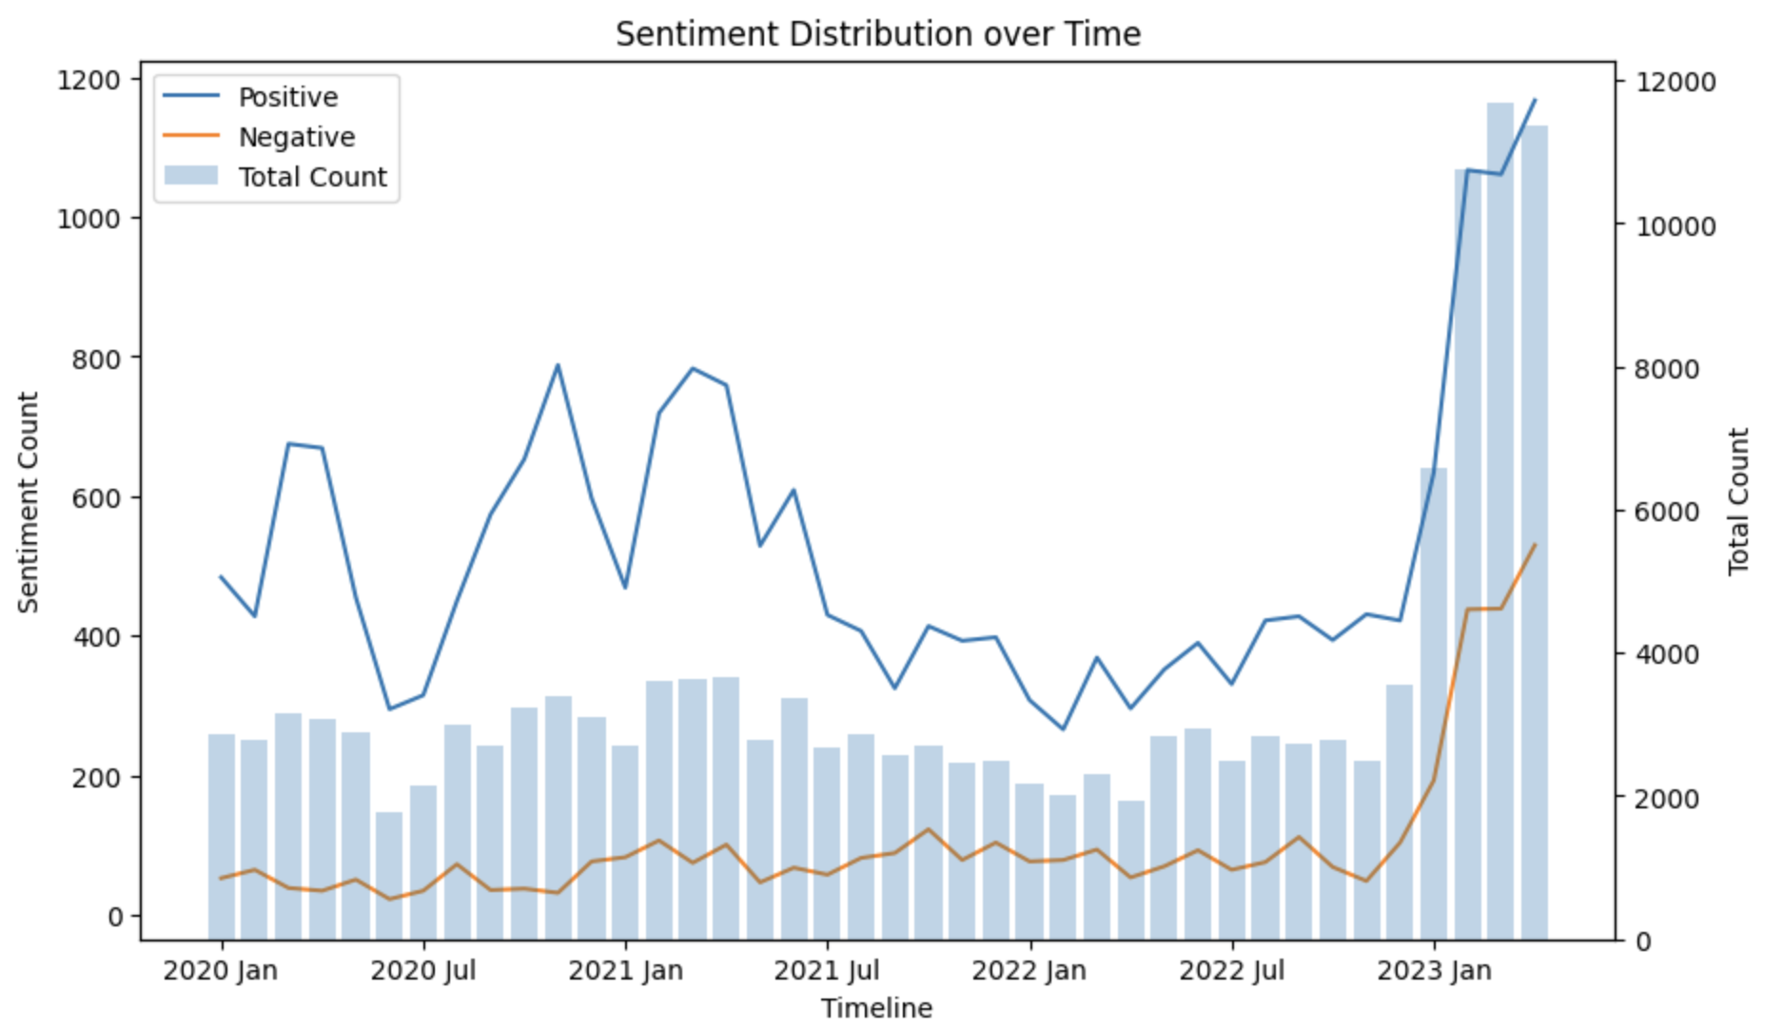
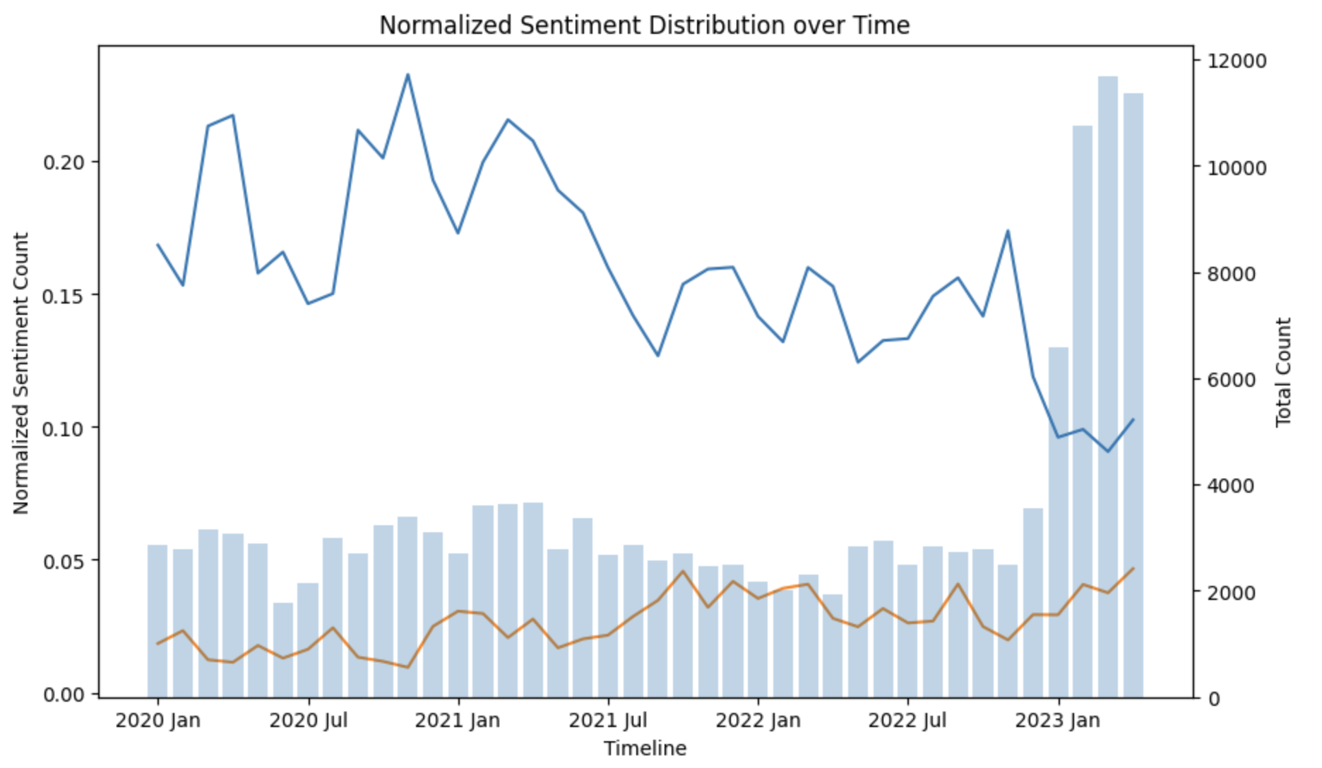
Article and Sentiment Trends Through Time
Using distilroberta-finetuned-financial-news-sentiment-analysis
Though we can observe an influx in the number of articles related to technology and development in 2023, normalized sentiment peaks can be observed in late 2020, early 2021 and late 2022

Slide 6
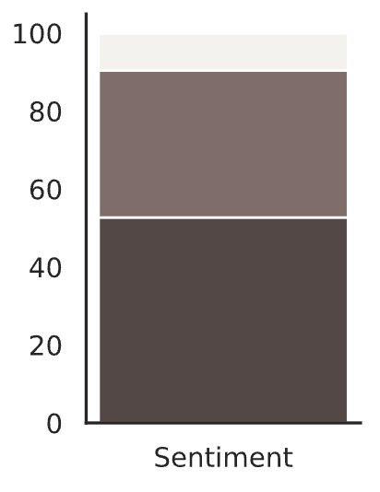
BERTopic Modelling Overview
Sentiment Analysis is done using twitter-roberta-base-sentiment in order to identify and eliminate the Neutral class.
Neutral 9.5%
BERTopic applied on each of these classes to identify major topics reported in the news and understand the sentiment around these topics
Positive
Negative
Negative 38%
Total BERTopics
Reduced number of topics
139 95
Positive 52.5%
30 30
Next Steps :
Identify major topics of discussion in each sentiment class
Delve into the WHO, WHAT, WHERE details for each of these topics
Select topics of interest and observe their sentiment trend over time

Slide 7
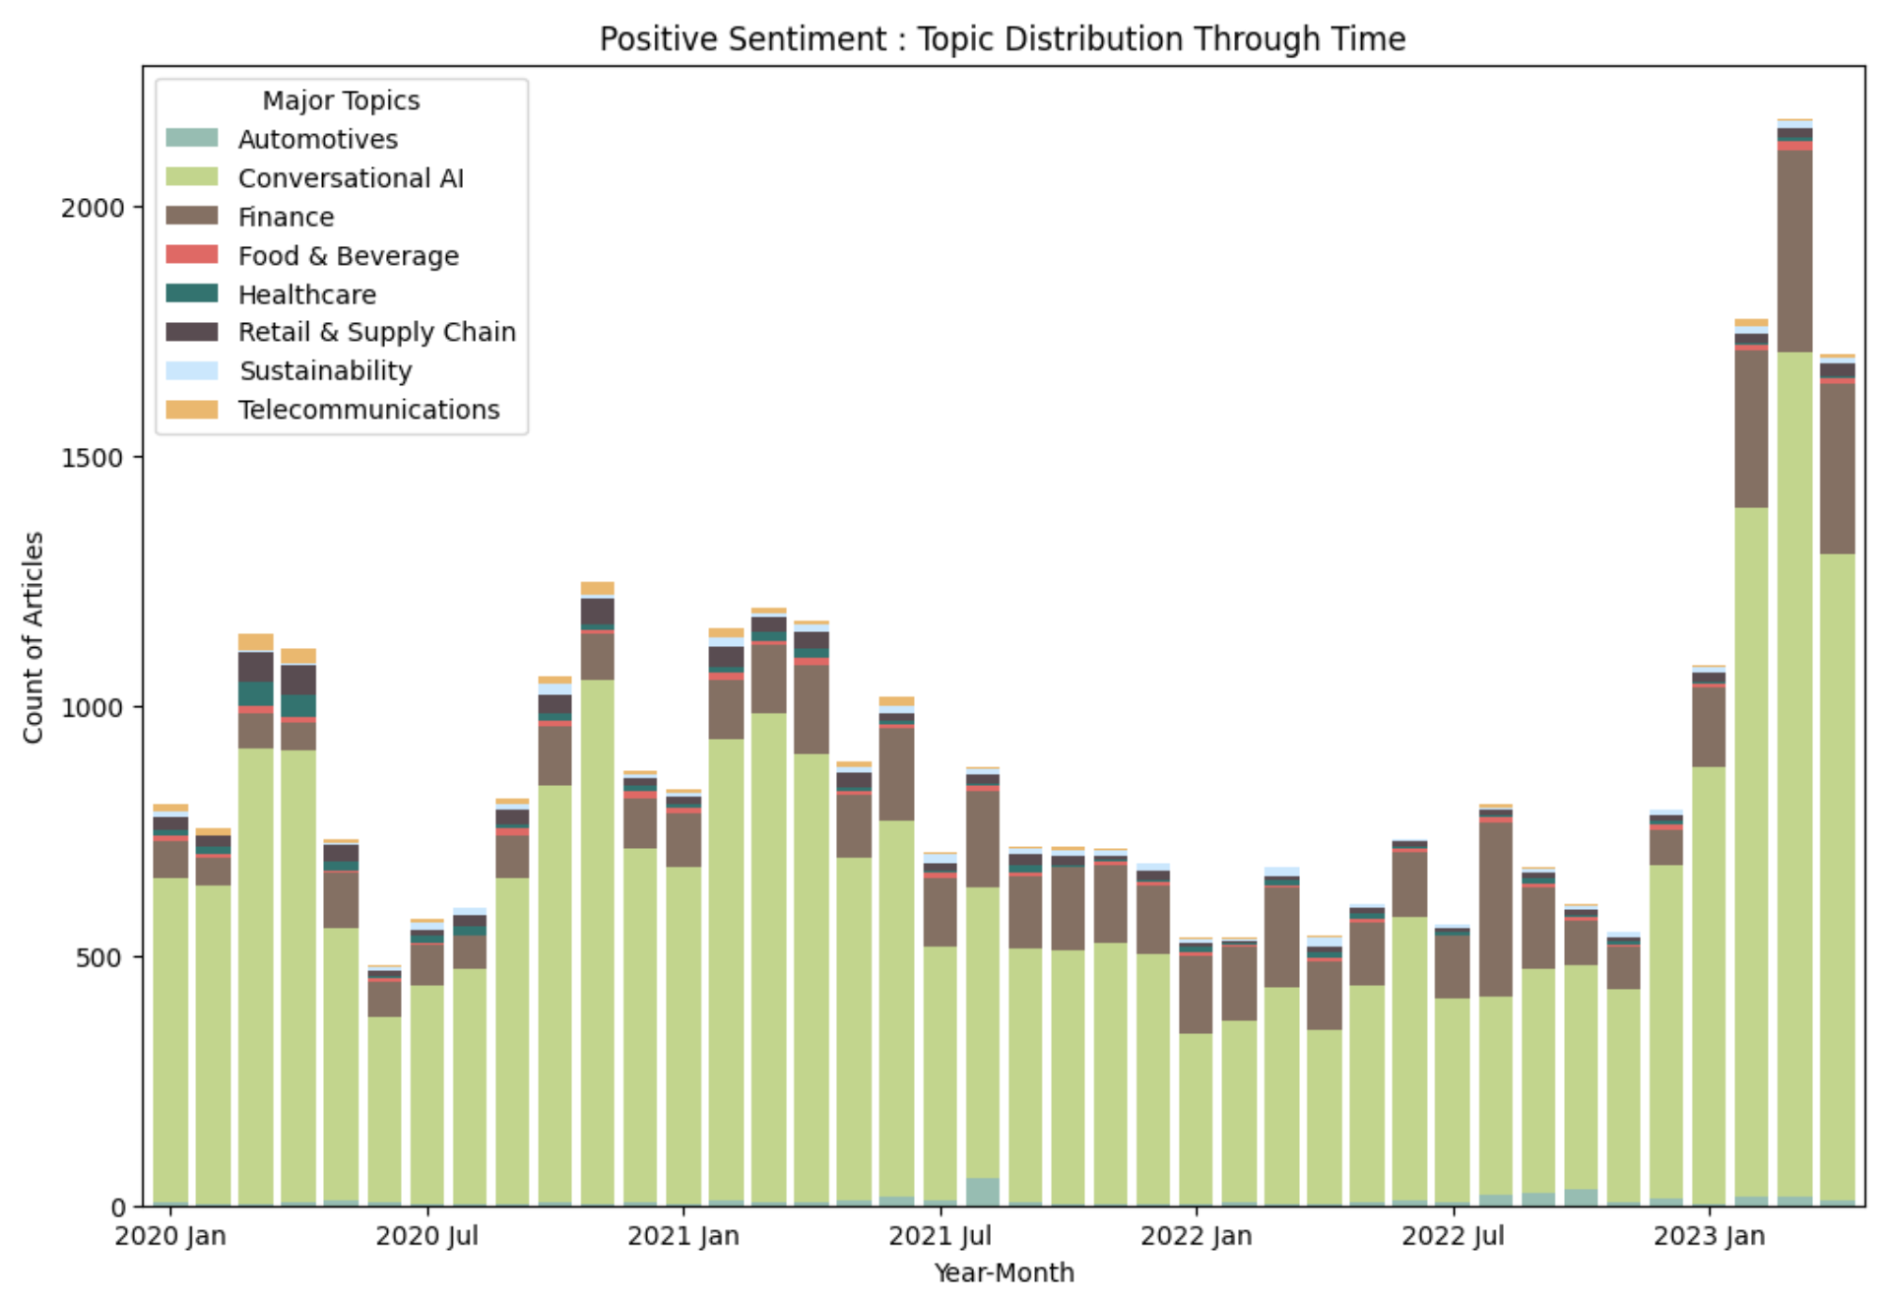
Exploring Positive Sentiment
Findings (Summarized for top entities* using ktrain) :
Topic 1 : Automotives
Autonomous driven Lyft robotaxi powered by Argo AI’s technology in Ford vehicles in Austin
Elon Musk debuts ‘Friendly’ humanoid Tesla Bot, Optimus during company’s AI day
Spin announces cutting edge on-vehicle AI platform to bring sidewalk riding and parking detection technology to cities across the US and UK
Audi using AI to design new wheels and Porsche using AI to suggest good driving roads
Self-driving delivery vehicle hits UK roads as government funds AI car projects
Topic 2 : Conversational AI
AI in Behavioral and Mental Health Care market projected to witness astonishing growth by 2026
Google building a 1000-language AI model to beat ChatGPT and Apple acquires AI Voice Startup Voysis to make Siri better understand our queries
OpenAI scraps waitlist For Its AI Art Generator Dall-E
Influx in Finance news is observed in 2023 and a strong positive sentiment an be observed in news about AI and technology through the years
* Top entities for each topic in Positive class illustrated in Appendix I and text summarisation available in 07_BERTopic_NER_Positive.ipynb

Slide 8
Exploring Positive Sentiment
Conversational AI contd.
Facebook is creating an AI that can view the world and interact with it like a human and PDFgear’s new ChatGPT-Powered feature allows users to chat with PDFs
Using AI to digitally replicate human voices, Anthony Bourdain's Voice Recreated For New Documentary
Topic 3 : Finance
SoundHound Voice AI investors are lined up for success as stocks soar to new heights
AI in Medical Diagnostics Market worth $3,868 million by 2025
UK based TrueCircle, a compute vision startup scoops $5.5M to use AI to drive recycling efficiency
PreciTaste raises $24M to redefine foodservice operations with Vision AI technology
Topic 4 : Food & Beverage
Gastrograph, an AI platform models human sensory perception uses AI to help companies predict and personalize flavor for new food products
Brightseed finds nutrients inside plants with AI to improve human heal
Food & Beverage contd.
Tastry AI recommends perfect wine acting as a personal sommelier based on Artificial Intelligence
InteligentX Brewing Co. has created a premium beer that uses Machine Learning algorithms to improve itself from feedback
Kroger launches Chefbot, a first-of-its-kind AI Twitter Tool that delivers personalized recipe recommendations based on ingredients already in users’ kitchens.
Topic 5 : Healthcare
In 2022, the FDA authorized 91 AI and ML enabled medical devices
Google's DeepMind created an AI for spotting breast cancer that can outperform human radiologists and is more trustworthy than experts at reading medical scans
Lunit’s AI Solution for Breast Cancer Detection wins commercial approval in Taiwan
In virus-hit South Korea, AI monitors lonely elders
Paige raises $5 million more from Goldman Sachs to detect cancer with computer vision. launching the first FDA-Authorized AI Software for Digital Pathology

Slide 9
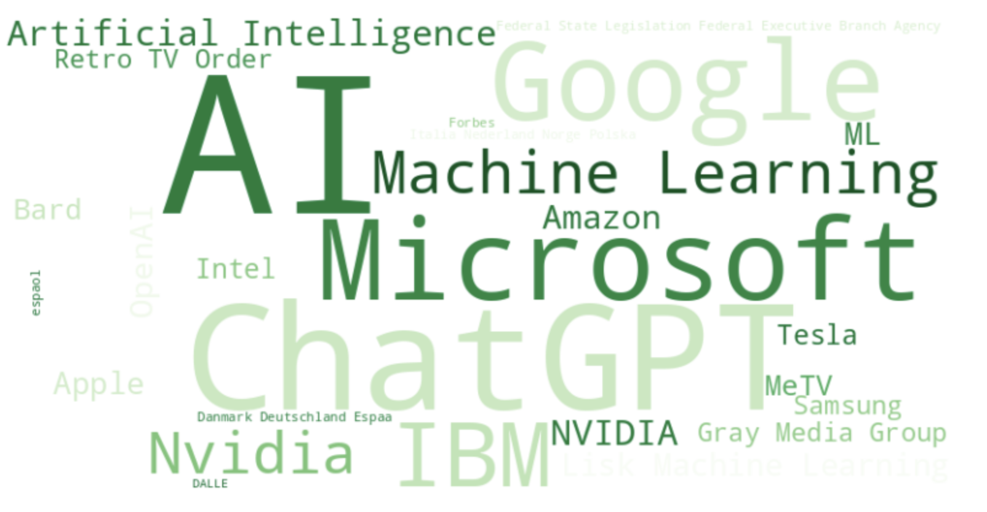
Exploring Positive Sentiment
Sustainability contd.
BrainBox AI deploys its climate tech solution in Sleep Country’s stores across Canada to reduce their retail network’s carbon footprint
Topic 8 : Telecommunications
Artificial Intelligence in the Telecommunication Market is projected to perceive substantial growth by 2030
5G, AI combine to empower wide array of socio-economic fields in China
IBM Broadens 5G Deals With Verizon, Telefonica in the Cloud and AI domains
Topic 6 : Retail & Supply Chain
Walmart rolling out AI Solution for on-shelf availability in Canada
North America AI in Fashion Market expected to grow from US$ 128.7 Mn in 2018 to US$ 2254.2 Mn by the year 2027
South African retail mainstay Shoprite has revealed that it is testing an automated Checkers concept store that features no cashiers and no till points running on AI and Machine Vision
Dynamic Pricing AI secures €600K from Bulgarian VCs
Topic 7 : Sustainability
Studies show that ML can predict disasters, pandemics, bridge collapses and climate change and Artificial Intelligence is being groomed to identify climate 'Tipping Points’
McD using AI to monitor recycling and IBM to help track global plastic waste in the environment
Kimberton Whole Foods fights food waste with Shelf Engine AI, growing sales and cutting out-of-stocks and shrink by automating inventory management
Aquicore raises $14 million for AI tools to optimize commercial building energy usage and China is using AI and 3D printing to build a 590-foot-tall dam without the need for human workers
Researchers in US and China use machine learning to make better solar panels

Slide 10
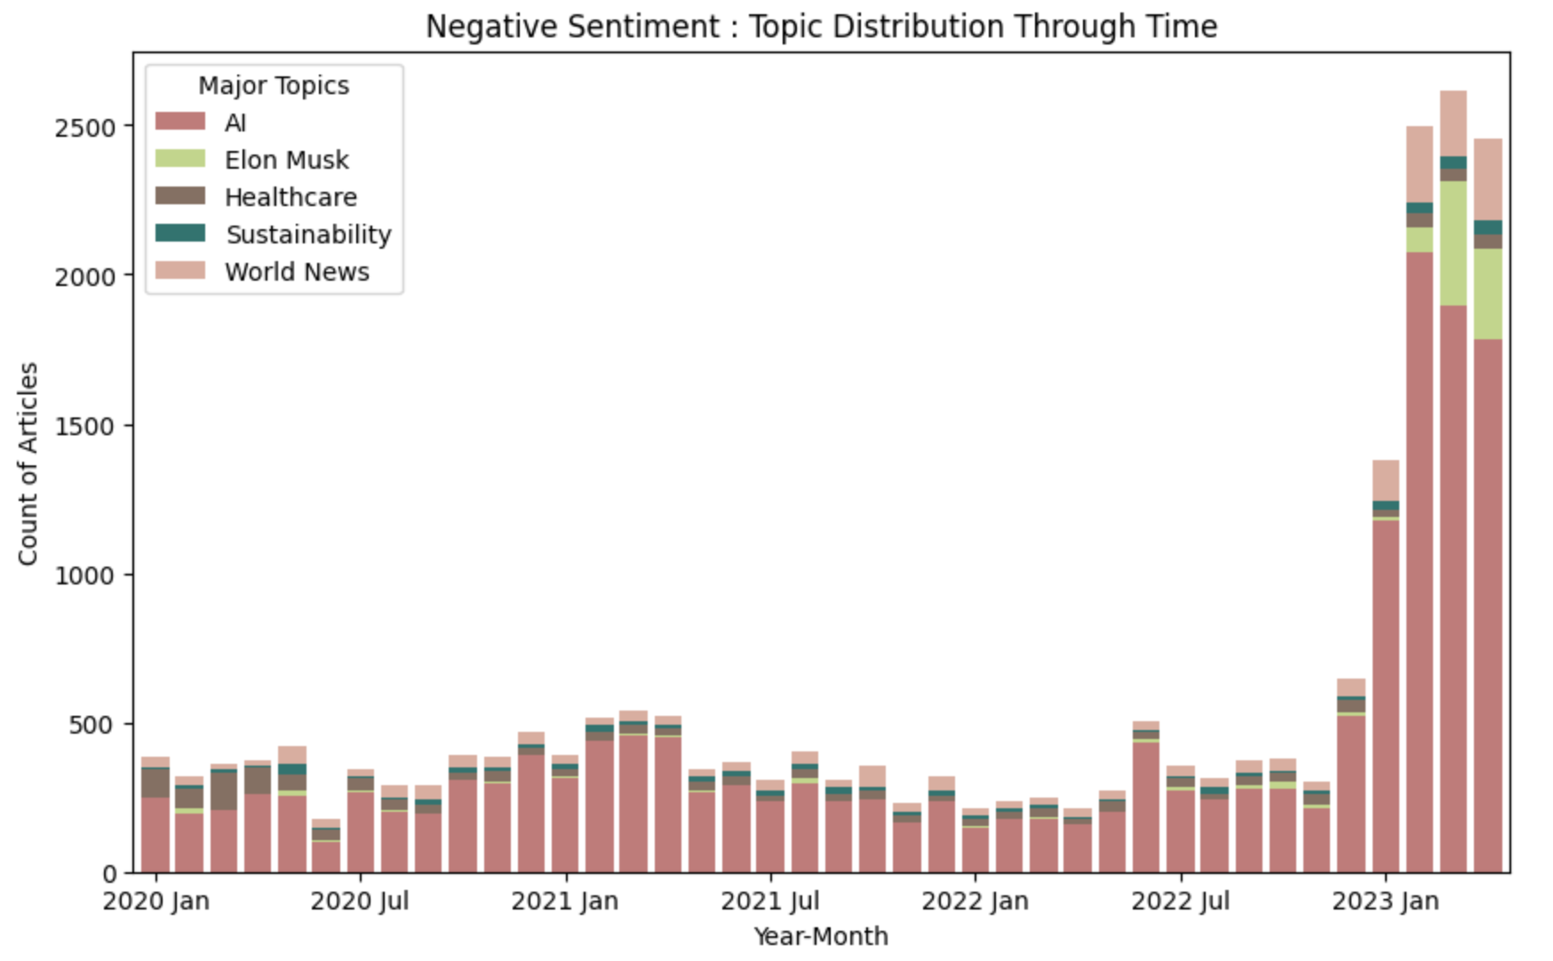
Exploring Negative Sentiment
Findings (Summarized for top entities* using ktrain) :
Topic 1 : AI
OpenAI addresses Italy's privacy watchdog action against ChatGPT due to a data breach
Sci-Fi magazine to suspend submissions due to flood of AI-generated stories
Google AI’s new chatbot BARD, made a $100B mistake in a demo ad
Timnit Gebru, Google's Co-Head of Ethical AI, claimed that she was fired for expressing concerns in an email regarding the company's AI practices
Microsoft bakes ChatGPT-like tech into search engine Bing
Microsoft hits the brakes on Bing AI Chatbot after it compares reporter To Hitler
Growing adoption of AI in the Telecommunication industry projected for 2025
Topic 2 : Elon Musk
Elon Musk takes a dig at netizens criticising futuristic tech
Elon Musk demand immediate pause of Advanced AI Systems citing 'risks to society’, claims TruthGPT will counter AI ‘bias’
ChatGPT lists Donald Trump, Elon Musk, Kim Kardashian and Kanye West as 'controversial'
Influx in news about Elon Musk observed in 2023 and news about AI and technology have been increasing through the years
*Top entities for each topic in Negative class illustrated in Appendix II and text summarisation available in 08_BERTopic_NER_Negative.ipynb

Slide 11
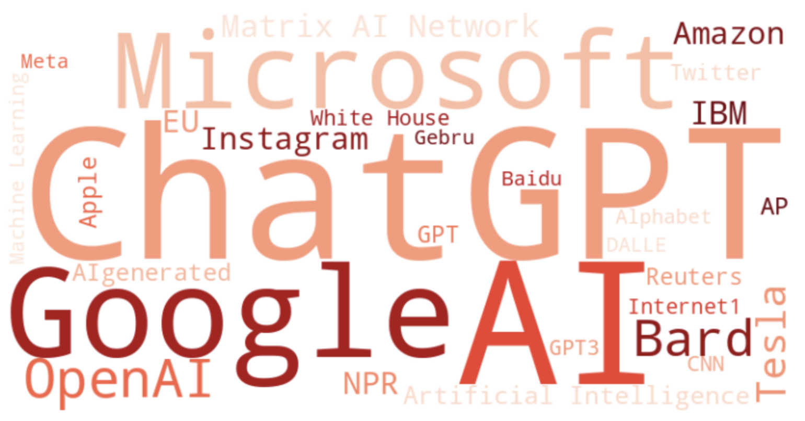
Exploring Negative Sentiment
Topic 3 : Healthcare
Text summarization shows us that healthcare is highly positive and does not really have negative sentiment. News is tagged as negative due to words like cancer, pandemic, etc.
Topic 4 : Sustainability
Greenpeace studies show Microsoft, Google reliant on fossil fuels despite 100% renewable energy pledges
Elizabeth Jardim, campaigner for Greenpeace USA reports that Google backs off on AI for Oil and Gas Extraction pledging not to build more custom AI to aid Fossil Fuel Extraction
ChatGPT data centres are consuming a staggering amount of water. Though research shows the carbon footprint of AI models, water consumption to run them on a large scale has remains under the radar
Topic 5 : World News
Artificial Intelligence Assistants To Outnumber People in China where Digital humans like Xiaoice, an AI-powered love bot are are revolutionizing human-computer interactions with their immersive experiences blending the digital and real worlds.
Baidu's launch of new AI product Ernie Bot raises questions about cybersecurity with shares falling after disappointing AI chatbot debut
World news contd.
Indian PM Narendra Modi emphasizes need to safeguard the world from the weaponization of AI, highlighting the importance of responsible AI development and usage.
Saudi Arabia signs MoUs with IBM, Alibaba and Huawei on AI whereas IBM Stock stock goes down after weak growth in cloud and AI revenue

Slide 12
Top 3 Entities of Interest
From the 2 WordClouds of our Positive and Negative classes we can select the most talked about topics and perform targeted sentiment analysis over time
Mars is actually a cold place. It’s full of iron oxide dust
Google
Microsoft
ChatGPT

Slide 13
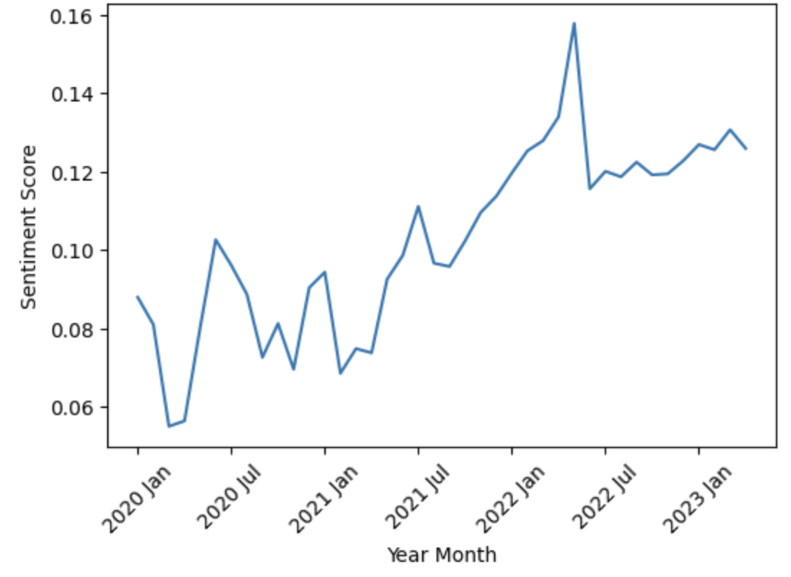
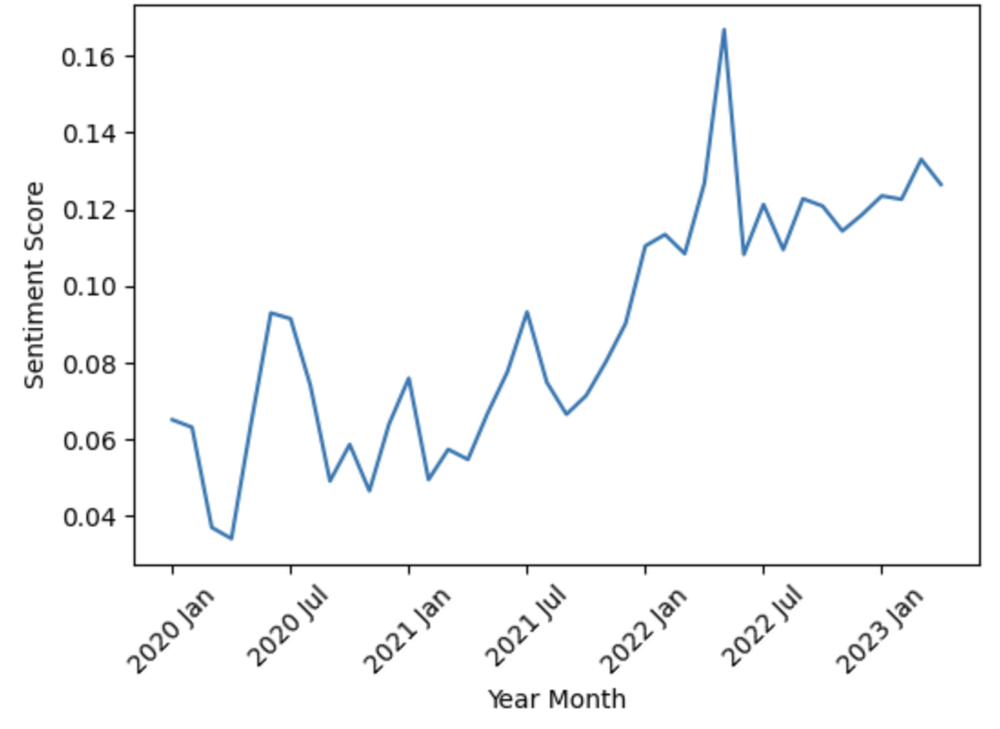
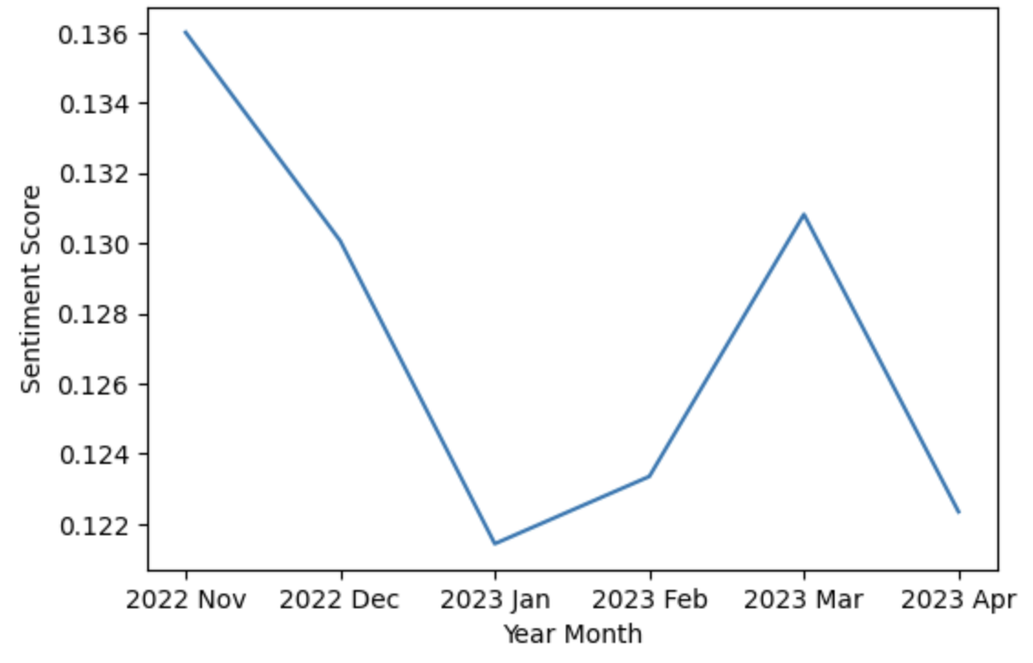
Targeted Sentiment Trend
Google
Microsoft
ChatGPT
Both Google and Microsoft show similar trends in their sentiment timeline
Peaks in Q2 2022 can be seen due to Google firing Blake Lemoine, the engineer who claimed AI chatbot LaMDA was sentient
Sustainability concerns raised around the fact that Microsoft, Google are reliant on fossil fuels despite 100% renewable energy pledges
Microsoft, GitHub, and OpenAI are being sued for allegedly violating copyright law by reproducing open-source code using AI
Major buzz caused by the successful launch of ChatGPT in Late 2022
Negative sentiment as Apple, Goldman Sachs, Samsung and other market leaders ban ChatGPT at work due to concern around privacy risks

Slide 14
Actionable Recommendations
Customer Service: Continuously innovate conversational AI models to enhance natural language understanding and improve user interaction. Foster the growth of AI in behavioural and mental health care to provide personalized and accessible support to individuals. Conversational AI and Chatbots can handle customer inquiries and support, reducing the need for human agents in routine interactions
Taxi, Ride-hailing Services and Public Transportation: Advance Autonomous Driving technology and invest in AI-powered vehicle design and optimization
Finance Audits: Utilize AI in financial diagnostics and analysis, and leverage vision AI technology for fraud detection and risk assessment
Food & Beverage Industry: Optimize flavour profiles, curate menus, meal planning and personalize products using AI platforms, and implement AI-driven recommendation systems. AI studies weather patterns, and market trends, to optimize inventory levels, reduce stockouts, and ensure timely delivery of food products
Healthcare & Therapy: Embrace AI-enabled medical advances in medical diagnostics, personalized medicine, drug discovery and development, remote patient monitoring, telehealth administrative efficiency along with high precision robotic surgery and assistance. Conversational AIs can be leveraged for AI-Powered Virtual Therapy
Retail & Supply Chain: Implement AI solutions for inventory management and on-shelf availability, and utilize AI in fashion for personalized recommendations and AI assist in demand forecasting, inventory management, and logistics planning
Sustainability: Utilize ML and AI for disaster prediction and resource management, and implement AI tools for energy optimization and waste reduction. AI can be used for automated construction, safety monitoring and planning automation

Slide 15
Conclusion
Analysing the negative sentiments around AI, key challenges in adoption of AI are identified as follows
Robust data privacy and security measures are crucial to prevent data breaches and address regulatory concerns in AI applications
Responsible AI development is essential to address potential biases and risks associated with AI-generated content
Rigorous testing and quality control measures should be implemented to avoid costly mistakes in AI-powered systems and applications
Embracing AI technologies in the telecommunication industry requires considering potential challenges and prioritizing data privacy and security
AI adoption in healthcare should carefully consider ethical implications and prioritize human-centered approaches in patient care
Responsible use of resources is vital to minimize the environmental impact of AI applications

Slide 16
Areas of Improvement
New articles can be cleaned better by using robust cleaning methods in order to remove web crawl remnants like news agency info, news reporter names, recommended articles, social media tags (Instagram, YouTube) and other noise as they led to noisy NER entities
To implement Sentiment Analysis, pre-trained transformer models were used but inconsistencies spotted in topics generated during topic modelling (esp. negative healthcare topic). Some level of customisation and manual labelling required to correctly identify the sentiment of the text
With access to more computational power, there would be flexibility for more sophisticated and advanced models and NLP techniques to be implemented for the above tasks

Slide 17
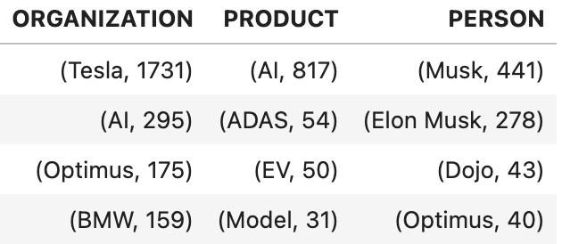
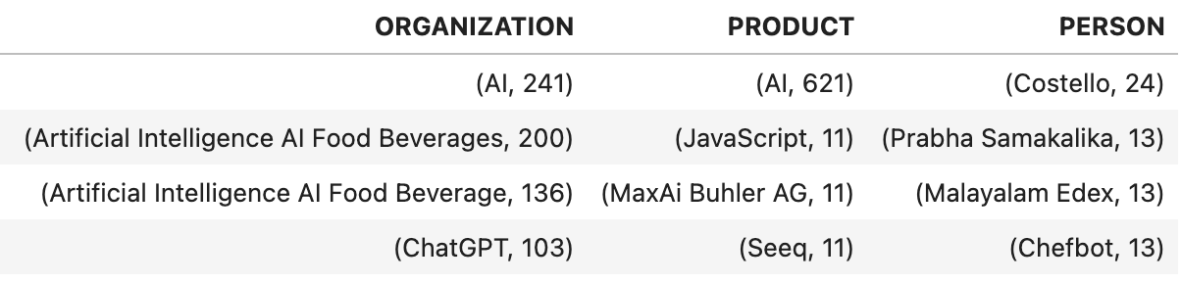
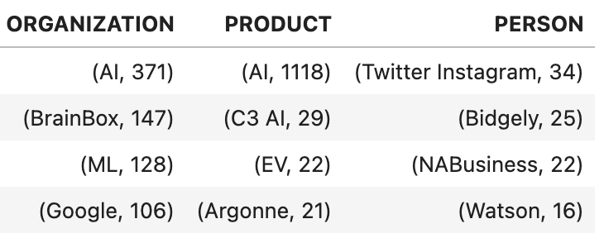
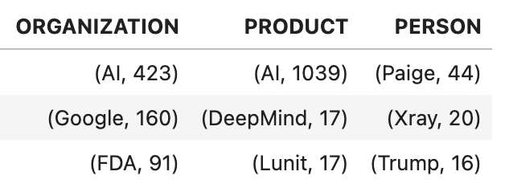
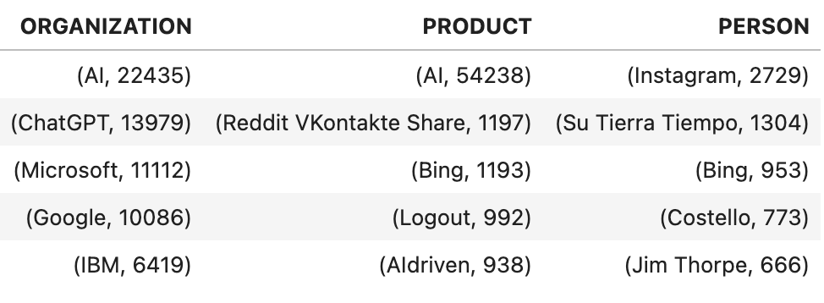
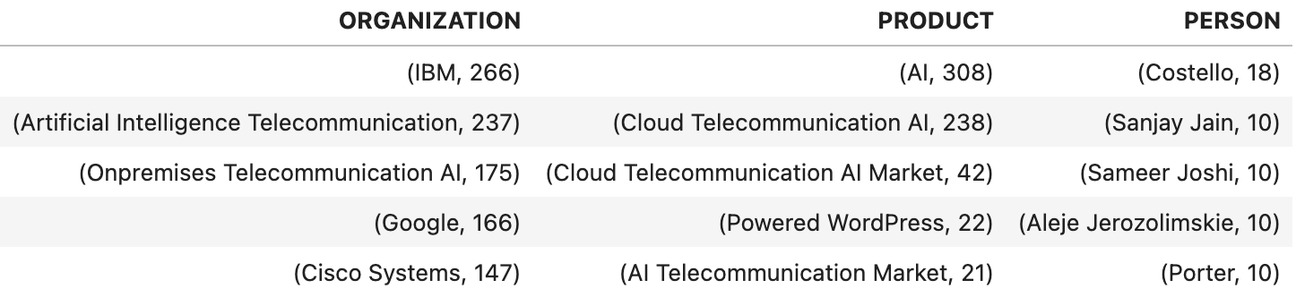
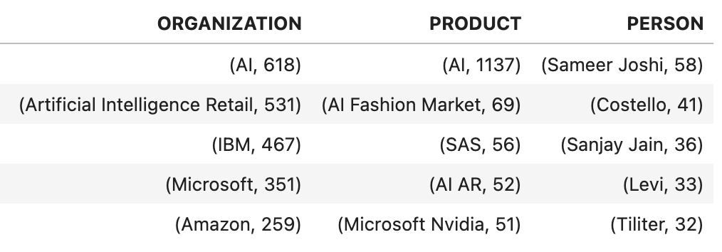
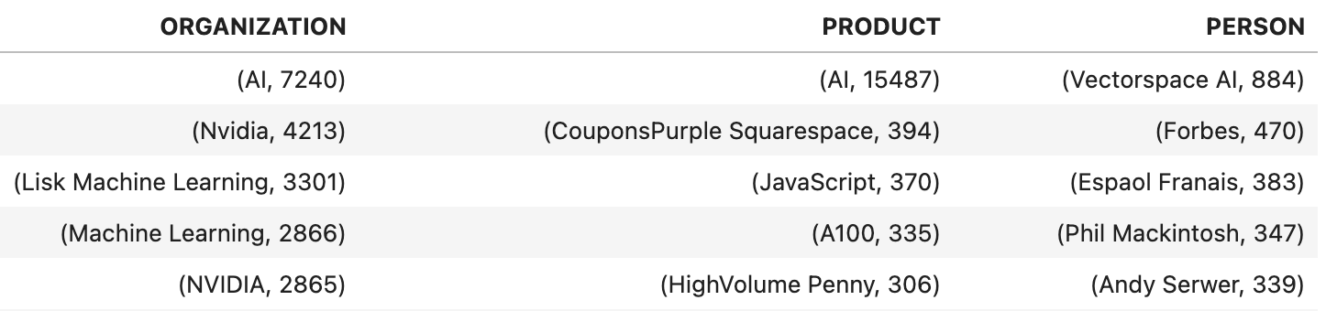
Appendix I Top named entities in the Positive class by Topic
FOOD & BEVERAGE
AUTOMOTIVES
SUSTAINABILITY
HEALTHCARE
CONVERSATIONAL AI
TELECOMMUNICATIONS
RETAIL & SUPPLY CHAIN
FINANCE

Slide 18
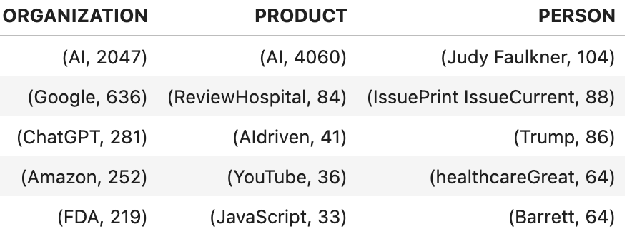
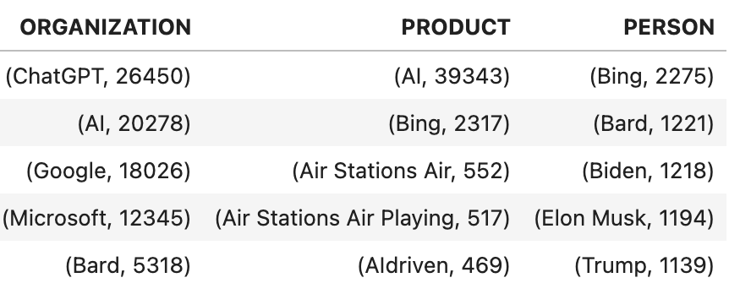
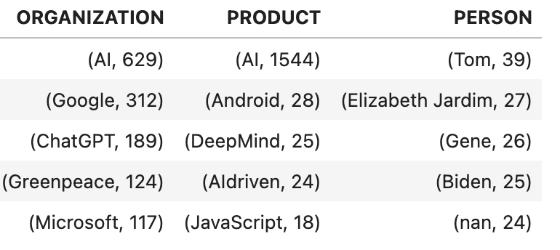
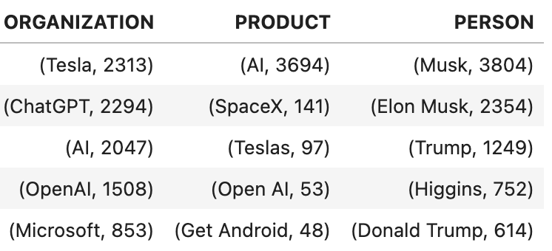
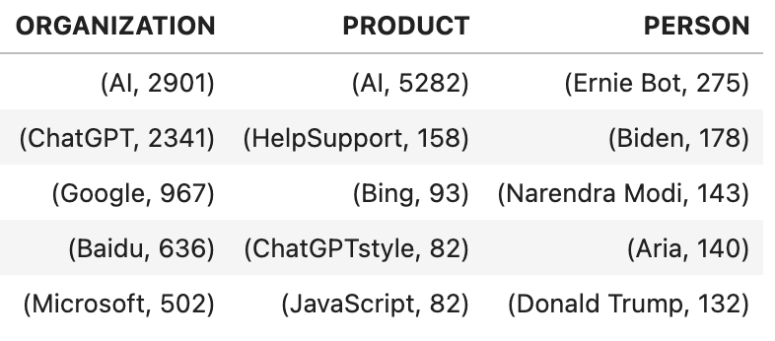
Appendix II Top named entities in the Negative class by Topic
HEALTHCARE
AI
SUSTAINABILITY
ELON MUSK
WORLD NEWS

